Slide 1
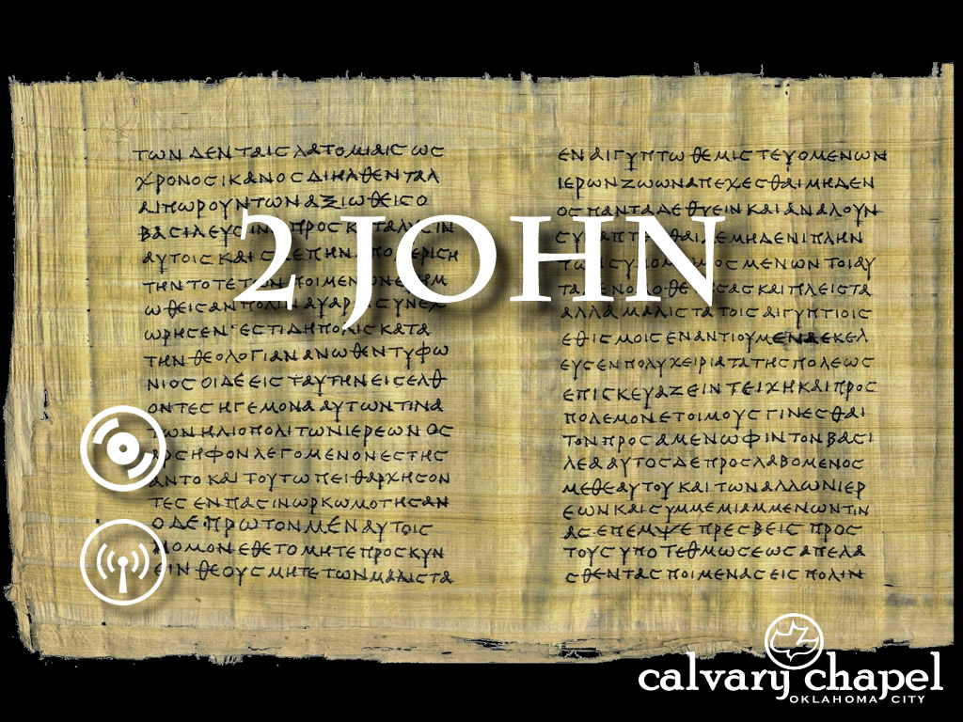
1:1-13
A CD of this message will be available following the service
A podcast will also be available later at calvaryokc.com

Slide 2
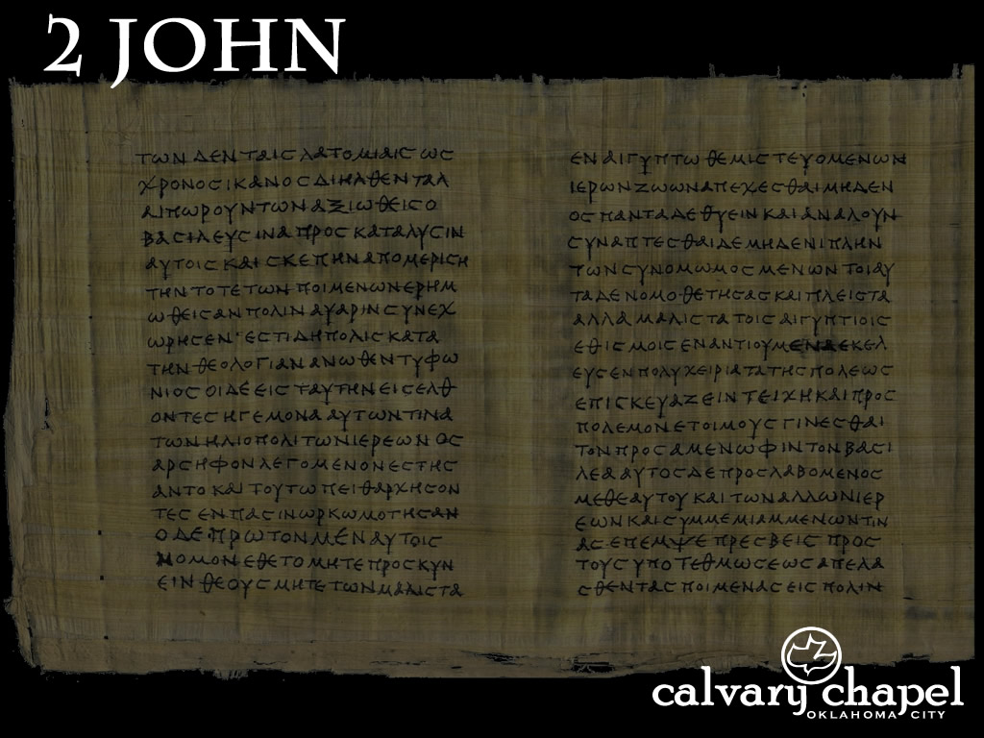



1:1-13
Having a wonderful time.
Wish you were here.
Send money.
This is love, that we walk according to His commandments.
For many deceivers have gone out into the world who do not confess Jesus Christ as coming in the flesh.
Mom and Dad
Elect Lady
1234 NW 5th St
General Delivery
Podunk, America
Ephesus, Asia Minor

Slide 3
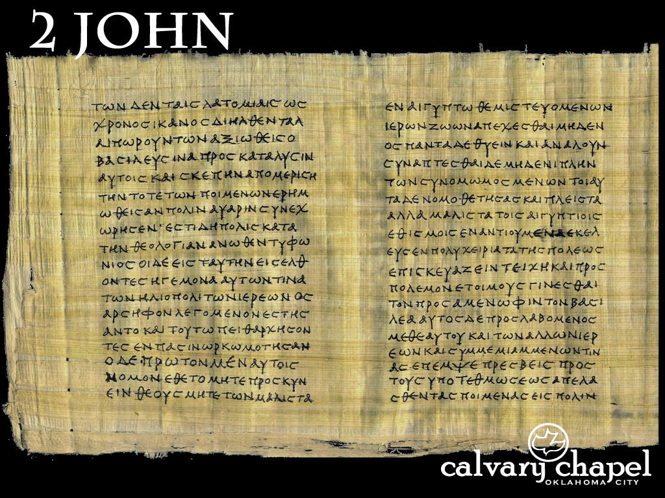
1:1-13

Slide 4


1:1-13
Letters of John
James
2 Thess.
Romans
Ephesians
1 Cor.
2 Peter
Hebrews
Colossians
Titus
AD 55
AD 60
AD 65
AD 70
AD 75
AD 80
AD 85
AD 90
1 Thess.
1 Timothy
Galatians
Philemon
2 Timothy
2 Cor.
Philippians
1 Peter
Jude
Instruction
Warning

Slide 5
1:1-13

Slide 6
1:1-13
lady ~ kuria, feminine of kurios (lord )
truth ~ 5x in the 1st four verses
love ~ 4x in the 1st six verses
Eph. 4:15 ~ but, speaking the truth in love, (we) may grow up in all things into Him who is the head—Christ—

Slide 7
1:1-13

Slide 8
1:1-13
Ezek. 33:30-32 ~ ³⁰ As for you, son of man, the children of your people are talking about you beside the walls and in the doors of the houses; and they speak to one another, everyone saying to his brother, “Please come and hear what the word is that comes from the Lord.” ³¹ So they come to you as people do, they sit before you as My people, and they hear your words, but they do not do them; for with their mouth they show much love, but their hearts pursue their own gain.

Slide 9
1:1-13
Ezek. 33:30-32 ~ ³² Indeed you are to them as a very lovely song of one who has a pleasant voice and can play well on an instrument; for they hear your words, but they do not do them.
lovely ~ sensuous love

Slide 10
1:1-13

Slide 11
1:1-13
Amy Carmichael ~ “If I can hurt another by speaking faithfully without much preparation of spirit, and without hurting myself far more than I hurt that other, then I know nothing of Calvary love.”

Slide 12
1:1-13

Slide 13
1:1-13
1 John 5:3 ~ For this is the love of God, that we keep His commandments; and His commandments are not burdensome.
agapē = selflessness

Slide 14
1:1-13

Slide 15
1:1-13
1 John 4:3 ~ and every spirit that does not confess that Jesus Christ has come in the flesh is not of God. (past tense)
as coming in the flesh; maybe better: is coming in the flesh (present tense)
ESV ~ those who do not confess the coming of Jesus Christ in the flesh.

Slide 16
1:1-13

Slide 17
1:1-13
We ~ 1st person plural
NASB, NIV ~ you do not lose ( not preferred)

Slide 18
1:1-13

Slide 19
1:1-13
transgresses ~ to turn aside
NIV ~ Anyone who runs ahead …
Phillips ~ The man who is so “advanced” that he is not content with what Christ taught has in fact no God.
abide ~ menō – to remain or to continue

Slide 20
1:1-13

Slide 21

1:1-13
“To some modern minds these instructions seem unduly rigid and harsh. A great part of the problem, however, lies in the modern inclination to be highly tolerant of religious differences. One must frankly face the fact that the New Testament writers did not share this spirit of toleration. Their commitment to the truth and their consciousness of the dangers of religious error called forth many stern denunciations of false teachers. Not surprisingly, this modern age, having a diminishing sense of the dangers of heresy, has lost its convictions about the truth.”

Slide 22
1:1-13

